Slide 1
Homework-4 Review
Introduction to Robotics

Slide 2
Part A: Image Filtering

Slide 3
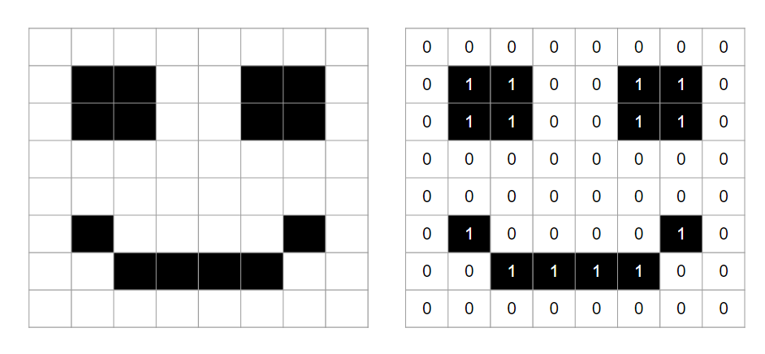
What Is A Digital Image?
A digital image is a representation of visual information in a digital format, composed of a grid of tiny elements called pixels
Binary image and its matrix

Slide 4
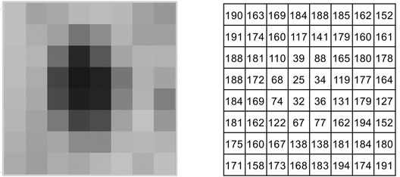
Grayscale Image And Its Matrix
A pixel's value in a grayscale image can be any number between 0 and 255.

Slide 5
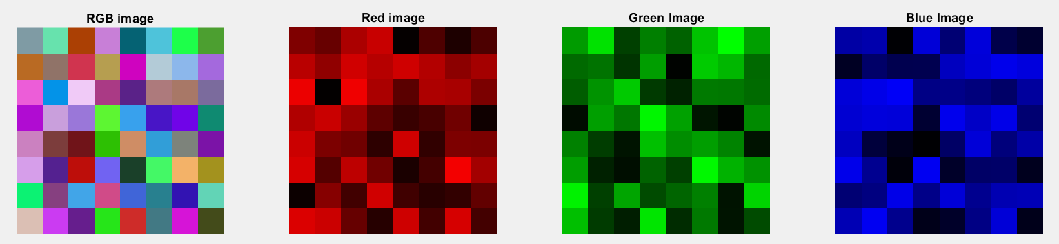
Color Image
Color images are composed of 3 matrices and those are the red channel matrix, green color matrix and blue color matrix

Slide 6
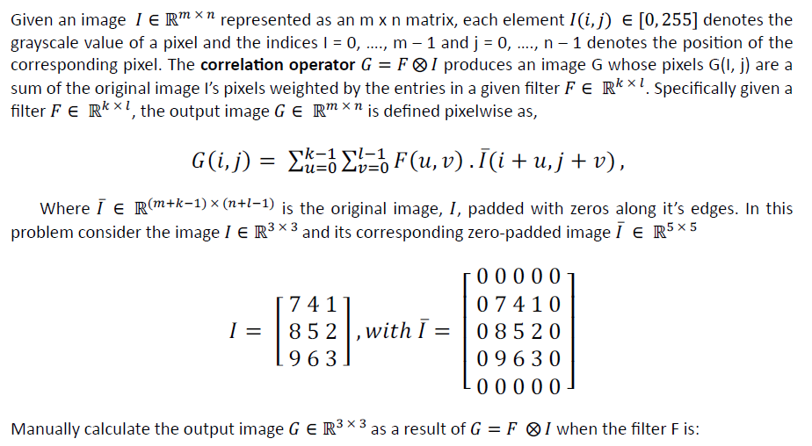
Problem 1

Slide 7
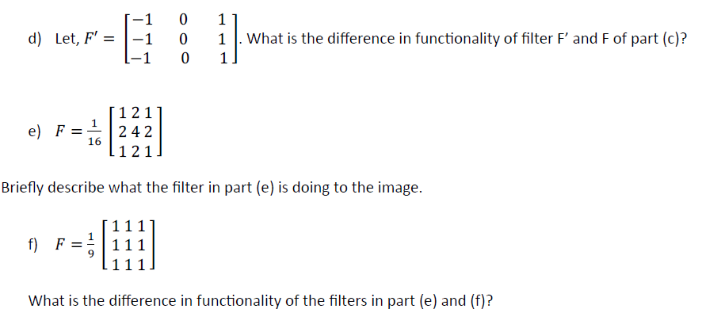


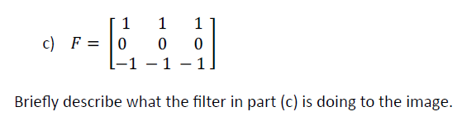
Problem 1

Slide 8
Problem 1
Step 1: Image padding
0 | 0 | 0 | 0 | 0
0 | 7 | 4 | 1 | 0
0 | 8 | 5 | 2 | 0
0 | 9 | 6 | 3 | 0
0 | 0 | 0 | 0 | 0
7 | 4 | 1
8 | 5 | 2
9 | 6 | 3
Image I
Image I after padding

Slide 9
Problem 1
Step 2: Create a output image matrix G
0 | 0 | 0 | 0 | 0
0 | 7 | 4 | 1 | 0
0 | 8 | 5 | 2 | 0
0 | 9 | 6 | 3 | 0
0 | 0 | 0 | 0 | 0
7 | 4 | 1
8 | 5 | 2
9 | 6 | 3
G(1,1) | G(1,2) | G(1,3)
G(2,1) | G(2,2) | G(2,3)
G(3,1) | G(3,2) | G(3,3)
Image I
Output image G
Image I after padding

Slide 10
7 | 4 | 1
8 | 5 | 2
9 | 6 | 3
G(1,1) | G(1,2) | G(1,3)
G(2,1) | G(2,2) | G(2,3)
G(3,1) | G(3,2) | G(3,3)
Problem 1
Step 3: Apply Filter And Save Output
Image I
Output image G
Calculating G(1,1) :
0 | 0 | 0 | 0 | 0
0 | 7 | 4 | 1 | 0
0 | 8 | 5 | 2 | 0
0 | 9 | 6 | 3 | 0
0 | 0 | 0 | 0 | 0
Filter
0 | 0 | 0
0 | 7 | 4
0 | 8 | 5
0 | 0 | 0
0 | 1 | 0
0 | 0 | 0
X
= 0+0+0+0+7+0+0+0+0 = 7 = G(1,1)

Slide 11
7 | 4 | 1
8 | 5 | 2
9 | 6 | 3
7 | G(1,2) | G(1,3)
G(2,1) | G(2,2) | G(2,3)
G(3,1) | G(3,2) | G(3,3)
Problem 1
Step 3: Apply Filter
Image I
Output image G
Calculating G(1,2) :
0 | 0 | 0 | 0 | 0
0 | 7 | 4 | 1 | 0
0 | 8 | 5 | 2 | 0
0 | 9 | 6 | 3 | 0
0 | 0 | 0 | 0 | 0
Filter
0 | 0 | 0
7 | 4 | 1
8 | 5 | 2
0 | 0 | 0
0 | 1 | 0
0 | 0 | 0
X
= ……… = G(1,2)

Slide 12
7 | 4 | 1
8 | 5 | 2
9 | 6 | 3
7 | G(1,2) | G(1,3)
G(2,1) | G(2,2) | G(2,3)
G(3,1) | G(3,2) | G(3,3)
Problem 1
Step 3: Apply Filter
Image I
Output image G
0 | 0 | 0 | 0 | 0
0 | 7 | 4 | 1 | 0
0 | 8 | 5 | 2 | 0
0 | 9 | 6 | 3 | 0
0 | 0 | 0 | 0 | 0
Do it till the end……

Slide 13
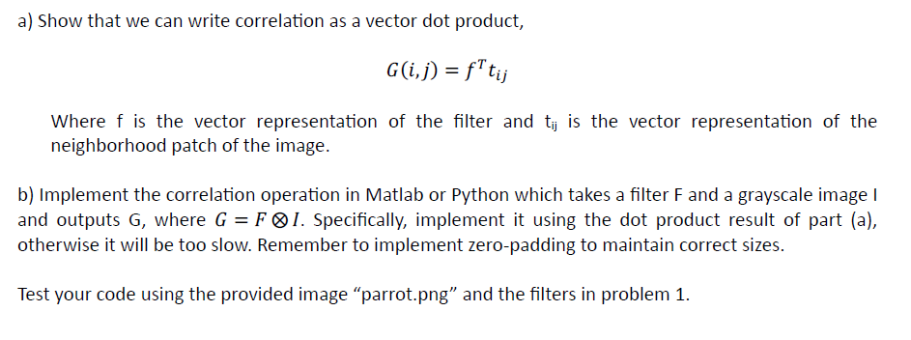
Problem 2

Slide 14
Problem 2 (A)
What is convolution?
What is correlation?
In which scenario convolution and correlation produces same result?

Slide 15
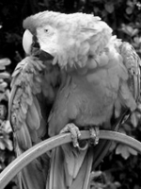
Problem 2 (B)
Step 1: Image padding
Step 2: Create a output image matrix G
Step 3: Apply Filter And Save Output

Slide 16
Part B: Line Extraction

Slide 17
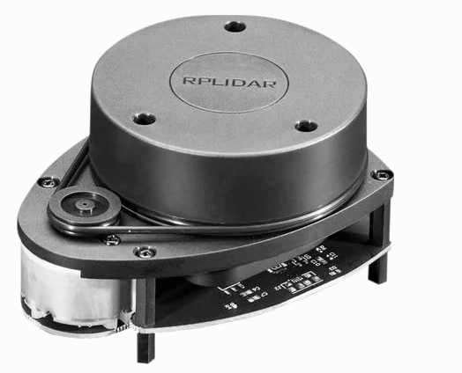
Lidar Sensor

Slide 18
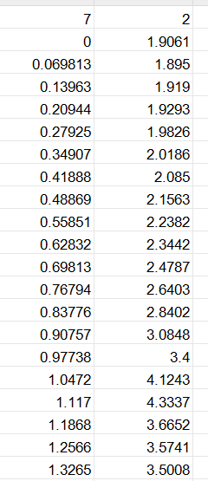
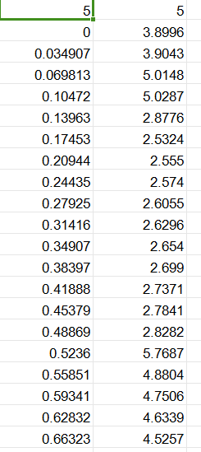
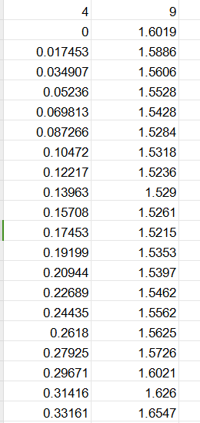
Dataset
rangeData_5_5_180.csv
rangeData_4_9_360.csv
rangeData_7_2_90.csv

Slide 19
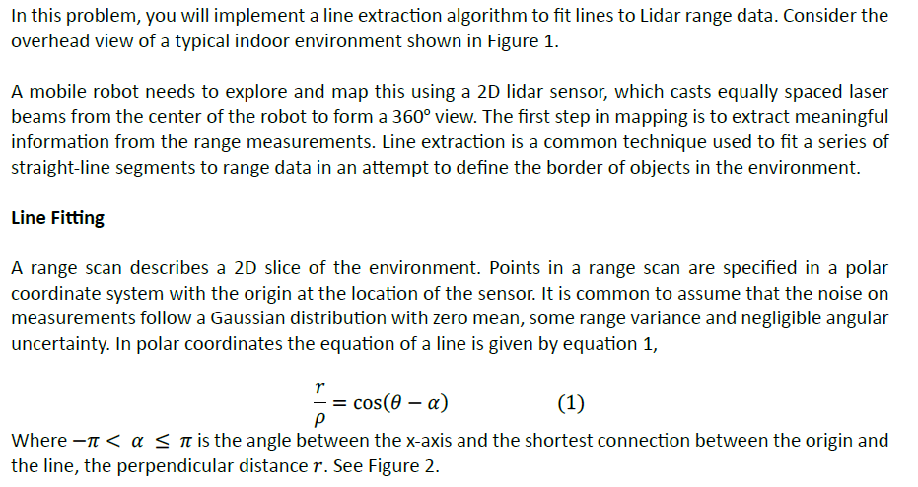
Problem 3

Slide 20
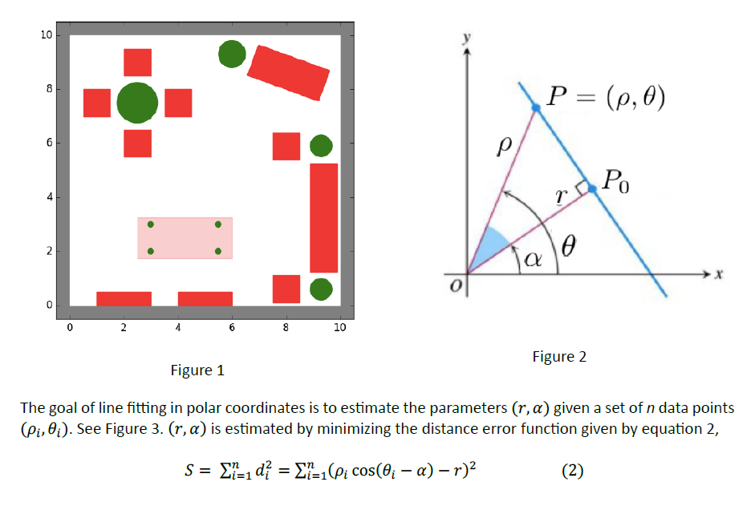
Problem 3

Slide 21
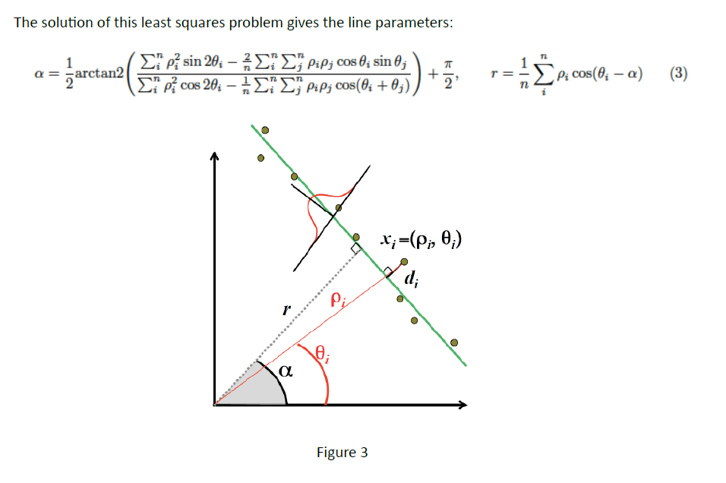
Problem 3

Slide 22
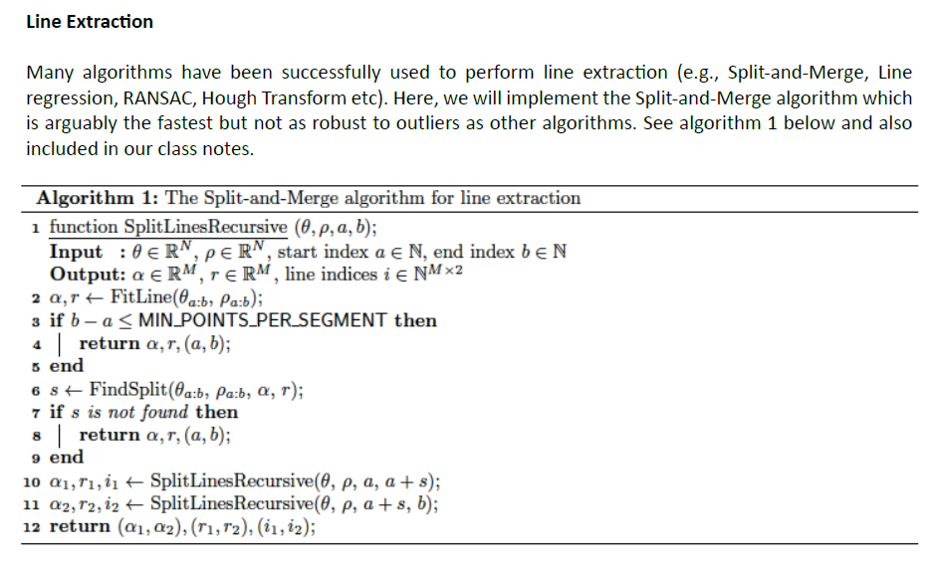
Problem 3

Slide 23
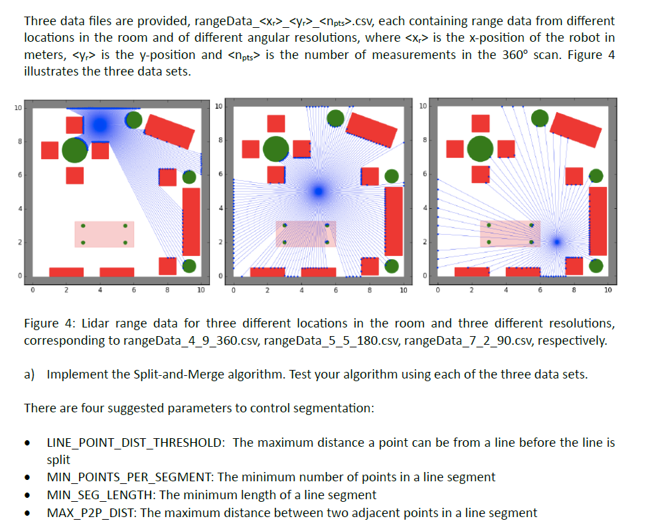
Problem 3

Slide 24
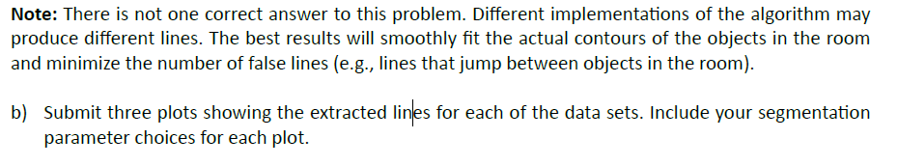
Problem 3

